Slide 1



MULTIMEDIA and COMMUNICATIONS
Computer Science CS1033a/b
Lecture #10
Intro to Video (Part 2)
Instructors:
Laura Reid (section 001)
Vivi Tryphonopoulos (section 002)

Slide 2
Lecture #10 Topics
Intro to Video- Part2
Compression Strategies
Data Rate
Codecs
File Formats
Terminology
Downloading Video
Streaming
YouTube
Review

Slide 3
Capture Video
(using video capture card )
from camcorder to computer
QUESTIONS TO CONSIDER
when preparing a video:
Where will I be viewing my video?
  On the web
  On CD-Rom
  DVD video
  Ipad?? Other devices
  Who is my audience?
  Will they be on different platforms
  (PC,Mac)
  How old will their computer be,
  how old will their DVD player be?
Will I still need to edit it later on?
Should I compress it at all?
Conan O’Brien video
Edit
Digital Video
(using Computer,
Digital Video software
ex. Adobe Premiere, Avid)
Edit it
Add all kinds of cool titles
Filters, transitions and FX
Superimpose clips
Synchronize audio with video
Output in different file formats
Output Video
(back out to tape, the Web, CD, DVD)

Slide 4

Why Compress? An Example
Assume we have video that is:
  1440 X 1080 pixels → 1,555,200 pixels per frame
  24-bit colour
  30 fps
  1 second long
  Audio is stereo so 2 channels
  Audio is 48,000Hz and
  16 bit = 48,000*1sec*16bits/sample*2=1,536,000bits
Video
  1,555,200 X 24 bits per pixel (for color) = 37,324,800 bits per frame
  37,324,800 * 30 frames per second * 1 second= 1,119,744,000 bits/8 = 139,968,000 bytes =133MB
Audio
  1,536,000bits/8 → 188 KB
Total
  133MB + 188KB =~ 133MB → LOTS OF STORAGE FOR JUST 1 SEC
  THUS a DVD could hold 35 seconds of uncompressed video
  … Not a very long movie ☹
FACTS
THAT’S WHY WE NEED TO COMPRESS!
Notes:
Images......know
Glossed over

Slide 5
Video Editing
RECAP: In order for video to be used in a multimedia application:
  Video must be in a digital form
  Issue: Optimize Download speed
What things do you think we should think about optimizing to decrease video file size?
  One thing to think about: what we did to an image to make it smaller
HOW?
Reduce File Size

Slide 6
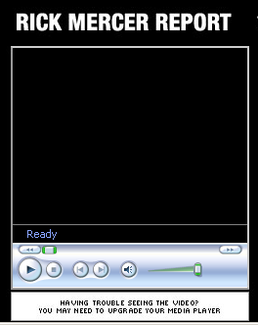
Video Editing: Optimizing for the Web
General Compression Strategies
GOAL: Lower the file Size - How?
Lower the _____________of the video
  If it was 640 by 480,
  change it to 320 by 240, less pixels!
Lower the __________of the video (frames/sec)
  Changing the frame rate by ½
  (say 20 fps to 10fps)
  will generally ½ the file size
Pick a _______ that does higher compression
320 x 240
Guidelines:
TV – 30 frames
Web Video 10-15 fps
Rob Mercer Report: 2006 at UWO
http://www.youtube.com/watch?v=pVhgt7CRSiM
http://www.youtube.com/watch?v=ntTSl4ALslg
So What is a Codec?

Slide 7
Video Editing:
Compression Strategies
CODEC: (coder/decoder or compress/decompress)
is a piece of code or program
compresses video or audio as it is created (exported from the editing software )
and then when displaying(playing) it to the user decompresses the video or audio
There are LOTS of codecs.
IMPORTANT: You have to use the same one to decompress that was used to compress a video.
Most common codecs are:
  Sorenson Spark
  H.264
  DivX
Compression technology
Reduces the ______ for transfer and storage
while maintaining quality
- Speed transfer improved -
Storage - Coded
View - Decoded

Slide 8
Codec Continued
Case: IF sometimes you get a piece of video on your machine and then not be able to play it, this is because you are missing the appropriate __________!
Codecs depend on the file format
What are the file formats available for video? (next slide)

Slide 9
Video Files
File Type | Also known as: | Originally created by | More Info | Platforms
.mov | QuickTime movie | Apple | Also for audio Supports MIDI Streaming with QuickTime Streaming Server Can watch video as it is downloaded Codecs→ Animation, Sorenson Video, H.264, PlanarRGB, Cinepak | Apple QuickTime player available for Mac and Windows
.avi | Audio Video Interleave | Intel | Codecs→ Microsoft RLE, Intel Indeo Video, Cinepak | Mostly windows but Apple QuickTime player can play avi files
.rm | Real Video | Real Systems | High compression Pick compression based on connection speed Can stream with Real Server Need for speed often compromises quality | Cross platform Need Real Player
.wmv | Windows Media | Microsoft | Good compression | Used with Windows Media Player
.mpg .mpeg | MPEG | Motion Picture Experts Group | mpeg-1→ VCD, mpeg-2→ DVD, mpeg-4→hand held devices (heavily compressed | Cross Platform
.flv | Flash Video | Adobe | Progressive download from webs server Can be streamed with adobe Flash Media Server Codecs→ Sorenson Spark, On2 VP6 (can have transparent video), H.264 | Cross Platform Need Flash Player to play a SWF file that holds the flv file
Smaller file

Slide 10
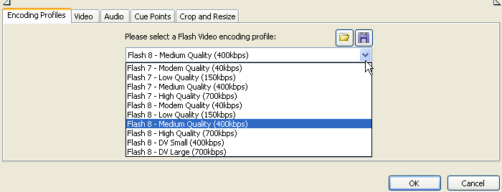
Compression Strategies Continued
General Compression Strategies
GOAL: Lower the file Size - How?
Pick a codec that does _____ compression
  QuickTime and AVI use different codecs so
  pick one that gives better compression.
Lower the ________ quality of the video
  Sorenson codec lets you set
  a limit on the data rate
  Some let you set the quality
FLV (Flash Video)

Slide 11
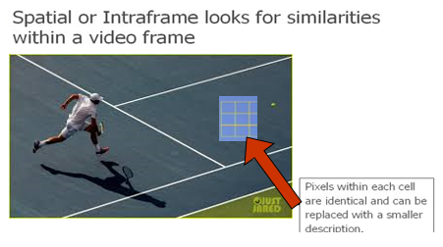

Spatial Compression
Temporal Compression
Compression Concepts
Spatial Compression vs. Temporal Compression
What can we do to
decrease file size of a video?
  Think about what you could do with the frames for:
  Jimmy Fallon Tonight Show
  vs. a tennis match
2 types of compression techniques
How does Compression work?
Similarities are encoded by
identifying differences:
Within a Frame --- ________
Between Frames --- __________

Slide 12
Spatial Compression vs. Temporal Compression
CONSIDER: Hot air balloon, Tennis match – Things are moving all the time!
Spatial (looks for similarities within a frame)
  Best suited for high action videos (fast movement)
  Compress each frame individually (it must find blocks of ____________)
  Uses the same techniques as JPG compression
  (looks for similarities within the frame and replaces it by a smaller description)
  Codecs that do spatial compression are: Animation, PlanarRGB
Looks for large blocks of data that
look the same
== lossless in images = does not discard

Slide 13
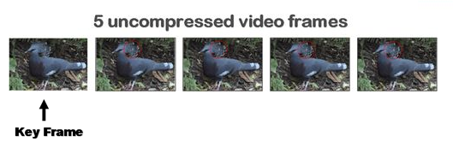
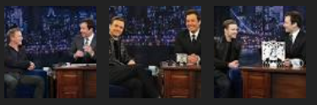
Spatial Compression vs. Temporal Compression
CONSIDER: Jimmy Fallon Tonight Show – Not a lot of action!
Temporal (identifies differences between frames and stores them relative to a ______________)
  Just save info on selected frames (called keyframes)
  All other frames just save the differences from the previous keyframe (Removes data that has not changed from one frame to another – ie. birds body Keeps the differences relative to the keyframe)
  Good when the difference between current frame and keyframe is small (watching Jimmy Fallon interview… not a lot of action)
  Codecs using temporal compression are: Sorenson Video, H.264

Slide 14
Compression Concepts
Lossless vs Lossy
RECAP
Same concept as with images
Lossy vs. Lossless
Spatial compression
  __________ (no loss of data)
  No loss of data but reduces file size
  looks for large blocks of pixels that are the same to encode
  QuickTime Animation and PlanarRGB are lossless
  Temporal Compression
  ___________ (discards data)
  Discards “repetitive” or “redundant” data;
  may not be noticeable to the eye
  Lowers video quality
  Better file size and better data rate

Slide 15
Sample Video
Laura’s Kid → OH BOY, home movies ☹
http://www.csd.uwo.ca/~lreid/kids/baby/
  mpg → 11M
  wmv →771K (0.7M)
  wmv → 363K (0.3M)
  flv → 6.6 M
http://www.csd.uwo.ca/~lreid/cs033/flvtest.html
Good quality but big file quality
Pixelated quality
Poorest quality
Best quality

Slide 16
Before HTML5, to insert video, the code looked like this ☹:
<object classid="clsid:D27CDB6E-AE6D-11cf-96B8-444553540000" width="475" height="269" id="FLVPlayer">
<param name="movie" value="FLVPlayer_Progressive.swf" />
<param name="quality" value="high" /> <param name="wmode" value="opaque" />
<param name="scale" value="noscale" /> <param name="salign" value="lt" />
<param name="FlashVars" value="&amp;MM_ComponentVersion=1&amp;skinName=Clear_Skin_1&amp;streamName=pictures_1&amp;autoPlay=false&amp;autoRewind=false" />
<param name="swfversion" value="8,0,0,0" />
<!-- This param tag prompts users with Flash Player 6.0 r65 and higher to download the latest version of Flash Player. Delete it if you don’t want users to see the prompt. -->
<param name="expressinstall" value="Scripts/expressInstall.swf" /> <!-- Next object tag is for non-IE browsers. So hide it from IE using IECC. --> <!--[if !IE]>-->
<object type="application/x-shockwave-flash" data="FLVPlayer_Progressive.swf" width="475" height="269">
<!--<![endif]--> <param name="quality" value="high" /> <param name="wmode" value="opaque" />
<param name="scale" value="noscale" /> <param name="salign" value="lt" />
<param name="FlashVars" value="&amp;MM_ComponentVersion=1&amp;skinName=Clear_Skin_1&amp;streamName=pictures_1&amp;autoPlay=false&amp;autoRewind=false" />
<param name="swfversion" value="8,0,0,0" /> <param name="expressinstall" value="Scripts/expressInstall.swf" />
<!-- The browser displays the following alternative content for users with Flash Player 6.0 and older. --> <div>
<h4>Content on this page requires a newer version of Adobe Flash Player.</h4> <p><a href="http://www.adobe.com/go/getflashplayer">
<img src="http://www.adobe.com/images/shared/download_buttons/get_flash_player.gif" alt="Get Adobe Flash player" /></a>
</p> </div> <!--[if !IE]>--> </object> <!--<![endif]--> </object>

Slide 17
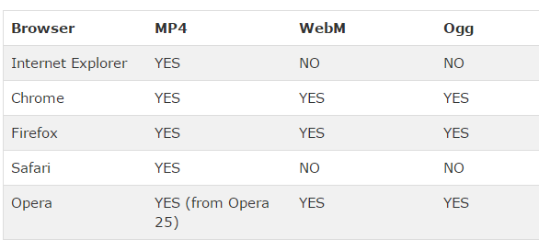
Inserting Video into your webpage using…HTML5
Currently HTML5 supports 3 video formats:
  _______
  _______
  _______
Have to worry about what browser your viewer is going to use:

Slide 18
HTML5 Video Formats
Apple is trying to get away from Flash so it won’t support .flv,
HTML5 does NOT support _________
HTML5 Standards group wanted:
  Good compression, good image quality
  Royalty free
  Hardware video decode as well as software (as some processors aren’t able to decode video)
Works on handheld devices too ☺

Slide 19
HTML5 supports →ogg, webm and mp4
Originally only wanted to use codec: Theora or Vorbis (.ogg containers) because they were open source but Apple wasn’t sure if they were open source
WebM another file format, royalty free, open source, backed by Google
  YouTube uses WebM
Apple and Microsoft only support the codec: H.264 which creates .mp4 files
  Used in blu-ray discs, vimeo, YouTube and iTunes
  H.264 is lossy but can do lossless

Slide 20
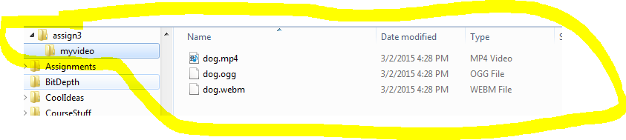
How to add video in HTML5
Make sure you encode your video as a mp4, ogg or WebM file using Adobe Encoder
Put your video somewhere inside the folder containing your website (perhaps a subfolder). E.g. if you folder is assign3, maybe put video in assign3/myvideo folder:
Make sure the first line of your webpage is:
  <!DOCTYPE html> (this indicates it is html5)

Slide 21
HTML5 <video> tag
Edit the html code in the assign3 folder (e.g. the index.html file) and put the following <video> tag where you want the video as follows:
QUESTION: What do you think each of these parameters do? (see next slides)
QUESTION: What do you think this does:
<video width="320" height="240">
<source src=“myvideo/dog.mp4" type=“video/mp4">
<source src=“myvideo/dog.ogg" type="video/ogg">
<source src=“myvideo/dog.webm" type="video/webm">
Your browser does not support the video tag.
</video>
<video width="320" height="240" controls autoplay loop muted poster=“doggy.jpg”>
<source src=“myvideo/dog.mp4" type=“video/mp4">
…
<source src=“myvideo/dog.mp4#t=10,22" type=“video/mp4">

Slide 22
HTML5 <video> tag
http://www.w3schools.com/tags/tag_video.asp
What does this tag do?
<video width="320" height="240" controls autoplay loop muted poster=“doggy.jpg”>
<source src=“myvideo/dog.mp4" type=“video/mp4">
  controls- has pause/rewind buttons
  autoplay – automatically begins to play
  loop- plays video over/over again
  muted - audio output of the video should be muted
  poster - Specifies an image to be shown while the video is downloading, or until the user hits the play button
<source src=“myvideo/dog.mp4#t=10,22" type=“video/mp4">
  Start at second 10 and ending at 22sec.

Slide 23
Other Terms You Need To Know
Container File Format
  avi A file format that:
    stores both the data (the frames)
    AND how to play the data (which codec to use)
  Some common containers are:
    avi sometimes has uncompressed video, just depends
    mov
    flv → (Note: swf is NOT a container file format)
    mkv → newest and open source. Allows you to store
    unlimited number of audio and video tracks.
Newer container formats support subtitles, chapters, etc…
Question: Why can your computer sometimes play one .avi file but then not play another .avi file?

Slide 24
Something else cool you can do with HTML5 and container file formats:
http://www.html5rocks.com/en/tutorials/video/basics/
Pick a subtitle (need to have the video set up specially but it is possible):
<video controls style="width:640px;height:360px;" poster="poster.png">
<source src="devstories.webm" type='video/webm;codecs="vp8, vorbis"' />
<source src="devstories.mp4" type='video/mp4;codecs="avc1.42E01E, mp4a.40.2"' />
<track src="devstories-en.vtt" label="English subtitles" kind="subtitles" srclang="en" default></track>
</video>
The <source element> lets you specify multiple formats as a fallback in case the user's browser doesn't support one of them.
The <track> element provides a simple, standardized way to add subtitles, captions, screen reader descriptions and chapters to your video

Slide 25
How do you insert a YouTube video into your webpage?
Steps:
  1. View and then cut the url for the video you want to include on your page, eg: https://www.youtube.com/watch?v=uJpaQWWgaC8
  2. cut just the part after …watch?v= so in our case it would be: uJpaQWWgaC8
  3. go into the html code for the page where you want put your YouTube video and insert this:
<!DOCTYPE html>
<html>
<body>
<iframe width="480" height="390" src="https://www.youtube.com/embed/uJpaQWWgaC8" frameborder="0">
</iframe>
…

Slide 26
Other Terms You Need To Know
Digital Media Players
  A piece of software that plays multimedia files (video or audio)
  These media players are free:
  Quicktime - Apple version of Windows Media Player for
  playing video files?
  Itunes - Apple software developed for playing audio files
  Flash Player, Real Player - other players
      Most media players including these above will play videos produced with a variety of codecs
      Good Review Video (start at minute 2)

Slide 27
Capture Video
(using video capture card )
from camcorder to computer
Edit
Digital Video
(using Computer,
Digital Video software
ex. Adobe Premiere, Avid)
Edit it
Add all kinds of cool titles
Filters, transitions and FX
Superimpose clips
Synchronize audio with video
Output in different file formats
Output Video
(back out to tape, the Web, CD, DVD)
Challenge:
Efficient Delivery via Web

Slide 28


Bandwidth and Bit Rate and Streaming
Bandwidth → how much data CAN be pushed across a connection (the capacity) in a given amount of time
  Similar to the pipe that comes into your house to bring water in. The wider the pipe the more water
  For years, Ethernet has been one of the best connections methods (100 Gigabits in 2010)
  QUESTION: what does this image imply about bandwidth?
  Doesn’t matter if place where getting video has awesome bandwith, but when it come into your house… the lower connection is as fast as it can come in.

Slide 29
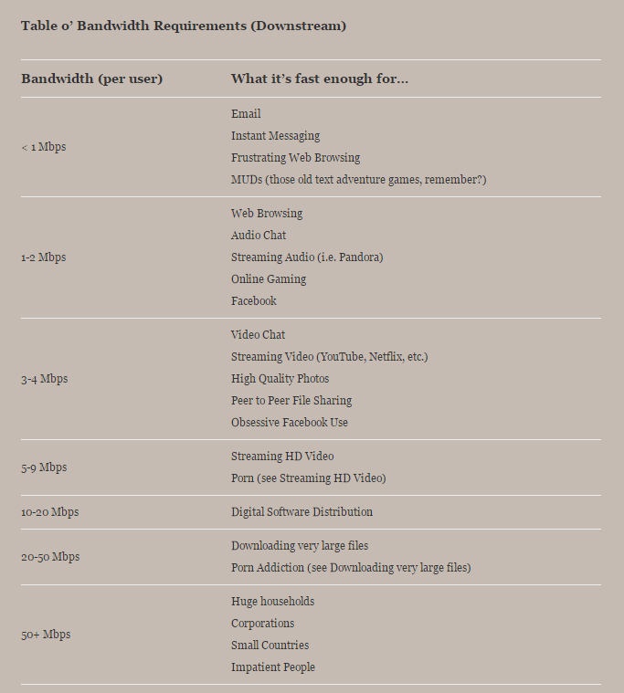
http://www.ctrl-shift.net/today/advice/how-much-bandwidth-do-i-need/

Slide 30
Bit Rate
Every time you record, export, or watch a video,
bit rate has a lot to do with the quality.
Def’n: Amount of data required to encode (compress) a single second of video or audio
Measured in megabit per second (Mbps)
or kilobits per second (kbps)
it's the number of bits that make up a section of video per a unit of time, i.e. 1 mb/s means that every second of video is represented by 1 million bits.
The higher the bit rate → better the quality of video
Affects:
  File Size
  Quality of your video so how it looks and how big the file is when you are uploading.
  Accessibility of the file is how fast an internet connection you need to view the file
https://www.youtube.com/watch?v=QOn-9anLFxA
Notes:
CS1033 Notes

Slide 31
Video on the Web
4 main ways to get video/audio (media) from a website onto your computer so you can view it:
  Download
  Progressive Download
  Streaming
  Adaptive Streaming
Media is either streamed or not streamed.

Slide 32
Video Transfer for the Web
3 main ways to get video/audio (media) from a website onto your computer so you can view it:
Adaptive
Streaming
Packets sent down & __________
starts playing
Video is NOT stored on end user system
Adapts to the ______ of the video –high or low
Download
___________
must be downloaded before it plays
- Permanently stored on end user system
Streaming
Packets sent down & __________
starts playing
- Video is NOT stored on end user system
Progressive Download
After ________video is downloaded, it begins to play
- Permanently stored on end user system

Slide 33
Video Transfer for the Web
Download
Usually uses ________ protocol
Downloads the Video from the host (server) to the user’s computer in its entirety and then plays the clip
User must wait for the download process to end before video can be played
Data is permanently stored on the end machine
Advantages:
Video can be played repeatedly once downloaded to end system
Can be copied if necessary
Higher quality video because we don’t have to compress to improve streaming
Disadvantages: Suitable for small video clips (____________)

Slide 34
Video Transfer for the Web
Progressive Download
A click begins the download, but AFTER some portion of the file has been downloaded, the video will start to play
The player (e.g. Windows Media Player) calculates the speed of the download and guesses when to start playing it.
Data that is sent is permanently stored on the end machine.
Advantages:
Same as downloads
Get to watch video earlier than true download
Disadvantage:
Interrupts occur while watching video (has to play “catch-up time”

Slide 35
Video Transfer for the Web
Streaming (uses RTSP protocol) aka as _______________
File played directly from server – thus some delay
the file is never permanently ________ to the users computer
Media begins to play as soon as it gets a packet
Needs a _______ server using a Real Time Streaming Protocol → RTSP
Video is broadcast to user and after displayed, discarded
Streaming is either On-Demand or Live
  On demand – videos are stored on server for a long time and streamgased on a user request
  Live – used for a sporting event, election results etc.
Streaming
Media that is constantly received by and displayed to an end user while being delivered by a streaming provider
Advantages: Fastest but requires the server be a streaming server
- Reduces waiting time for user
- Doesn’t take up disk storage
- great for long videos
Drawback: congestions may cause the media to stall if the download process can’t keep up with the playback

Slide 36
More on Streaming
Streaming either On-Demand or Live
  On Demand:
    streaming or progressive download.
    saves the file to a hard disk and then is played from that location.
    often saved to hard disks and servers for extended amounts of time.
  Live:
    while the live streams are only available at one time only (e.g. during the Football game).
    sends the information straight to the computer or device without saving the file to a hard disk

Slide 37
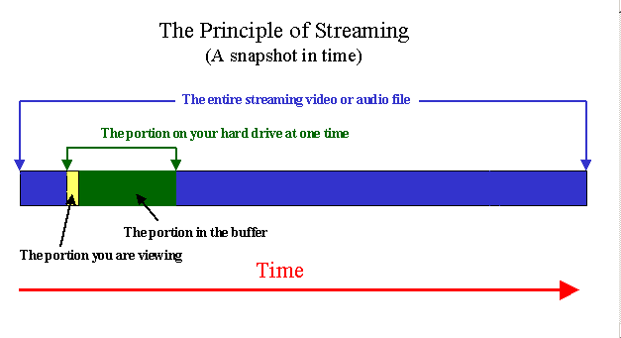
small __________is created on the user's computer
data starts downloading into it.
as soon as the buffer is full (usually just a matter of seconds),
the file starts to play

Slide 38
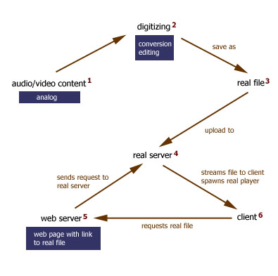
How does Streaming Work?
also known WEBCASTING
  In order to do streaming video, you need two things:
  A streaming web server (RTSP) – Real Server
  A video that has been converted to be ___________(aka real file in diagram)
RealServer serves media clips to clients. It allows users to stream, rather than download, the media clips.
Web server delivers pages to Web browsers over the Internet
CONTINUOUS

Slide 39
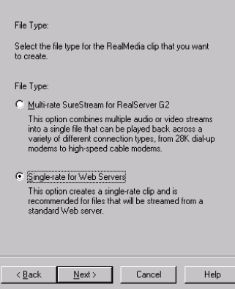
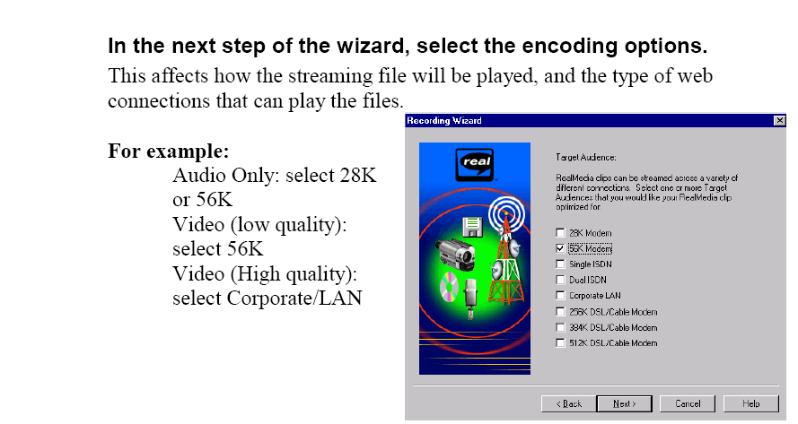
Converting the video:
  Because streaming involves passing lots of data very quickly you need to do LOTS of compression. The conversion program allows you to control this:

Slide 40
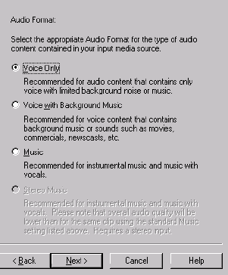
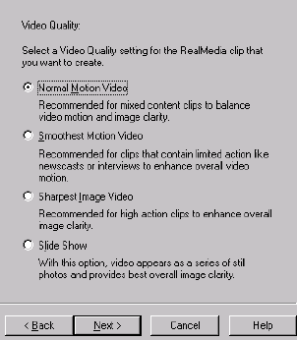

Slide 41
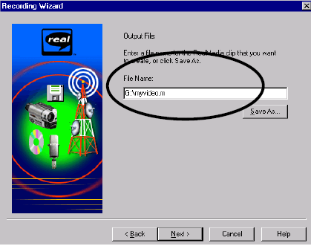
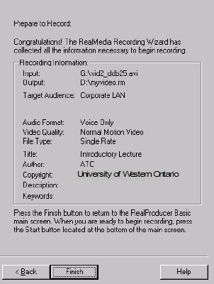
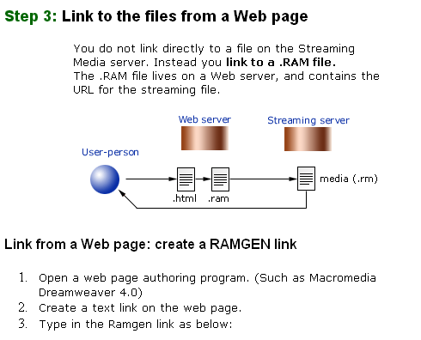
Extension .rm
(a stream file created)
HTML webpage links to a .ram file
Ram file (.ram) launches the RealPlayer and links to the clip

Slide 42
Streaming → Lots of Data ☹
Sometime requires special streaming server (RTSP)
Video starts almost immediately
If the data rate of the encoded video file is bigger than the bandwidth capacity of the viewer, the video will frequently STOP PLAYING ☹
Unicast vs. Multicast
  Unicast → each user gets his/her _____stream of video, the server has to send out A LOT of data if several users are watching at once
  Multicast → send the ______ stream to a bunch of users but then they lose the ability to pause, rewind, etc.
http://en.wikipedia.org/wiki/Streaming_media#Streaming_bandwidth_and_storage

Slide 43
What streaming service has completely changed the Internet (and the lives of many people)?

Slide 44
YouTube
YouTube used to do Progressive Download (it would start downloading and start playing as soon as there was enough in the buffer)
https://www.youtube.com/watch?v=Fal0IdL05JM&t=56
YouTube is now (because of 4K content) starting to do Adaptive Streaming
In adaptive streaming:
_________ a streaming server, can use http
the provider monitors your bandwidth, if the connection is not very busy (lots of bandwidth), high quality video is sent, if the connection is busy, low quality video is sent, this way it can “adapt” to the situation so the user never has to wait.

Slide 45
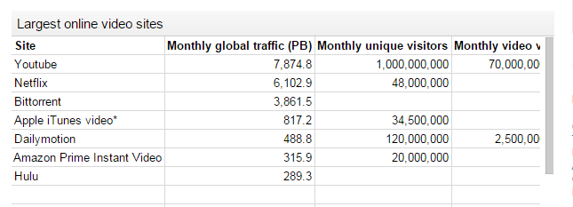
Largest online video sites (as of 2014)
More info about streaming websites
Great Review of the Concepts
Chart from: http://techexpectations.org/tag/dailymotion/

Slide 46
A Little More on YouTube
YouTube accepts video in the following formats: .WMV, .AVI, .MOV, MPEG and .MP4 but then converts them to the flv format (a Flash format) and uses one of: Sorenson Spark, V6 or H.264 video codec
YouTube used to output everything in as either .flv or .f4v (Flash video) as every computer had Flash
QUESTION: Why is YouTube moving away from Flash (HINT: what devices wont play Flash video)?
_________________________________

Slide 47
YouTube Quality
Moving towards HTML5 and now converting video to .mp4 files (still Flash compatible)
Quality
Standard (original) format 320X240 pixels, mono audio
March 2008 → up to 864X480 pixels and stereo sound
Nov 2008 → 1280X720pHD added, changed ratio from 4:3 to 16:9
Nov 2009 → 1080p HD support
http://upload.wikimedia.org/wikipedia/commons/c/c4/Youtubecompfull.png
  NOW even does 4K

Slide 48
Review
What file format does YouTube use? What newer file format is Flash Player pushing?
.avi is a container file format.
  True
  False
.avi files will always use the same codec to play them.
  True
  False
Name 3 ways of reducing the file size of a piece of video before moving it onto your website.

Slide 49
Warm up questions
Which of these will NOT affect the size of a video file?
Picture Size
Type of font used for credits
Number of Frames per second
Length of Clip
All of the above will affect the size
What is a codec?
A type of video capture card
A piece of software used for compression/decompress of videos and audios
A piece of software used to edit videos
None of the above
http://www.youtube.com/watch?v=6gmP4nk0EOE

Slide 50
Major Assignment - Tips
MARKING CRITERIA
Technical: File organization, file names (lower case)
Color Creativity: do colors balance? Esthetically pleasing, creative?
Website Design: Content, layout, style, links, consistency
Video: Word overlays, transformations, music, style
Animation: creativeness and how it was incorporated in the website
EVERYTHING MUST BE WORKING TEST IT ALL

